Slide 1
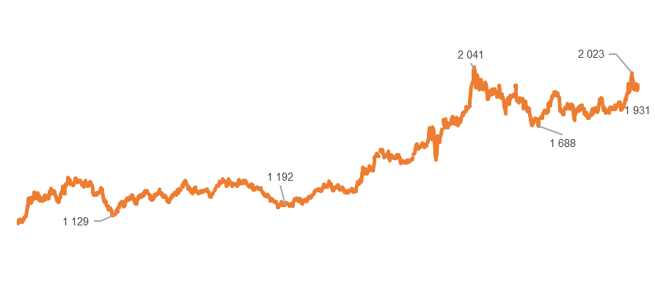
JSC NMC Tau-Ken Samruk
Results of the financial and economic activity for M6 2024
Key performance indicators*
Au
Ag
Production results
A 830 13%
P 770
8%
Gold production
A 4 -93%
P 112
96%
Silver production
thousand ounces
thousand ounces
A 503 41%
P 407 24%
Revenue
A 30 977 2 707%
P 5 952 420%
EBITDA
KZT billion
KZT billion
Gold, thousand ounces
Silicon, thousand tons
Silver, thousand ounces
Gold, USD per ounce (market)
A 9 899 27%
P 29 500 -66%
CAPEX
A 71 246 36%
P 82 782 -14%
Borrowings
The production of refined gold includes the processing of purchased (503 thousand ounces) and tolling (387 thousand ounces) raw materials.
The growth of gold production for the reporting period was due to an increase in the supply of gold-containing raw materials for smelting.
The silver production is an associated activity.
The production of metallurgical silicon was suspended (in Q4 2019 due to decrease in quotations for silicon).
KZT million
KZT million
* A – actual and percentage of growth in relation to the same period last year, P - plan and degree of the plan implementation

Slide 2
JSC NMC Tau-Ken Samruk
Results of the financial and economic activity for M6 2024
Financial indicators
KZT million | No. | M6 2023 | M6 2024 | Change | 2024 E
Revenue | [1] [2] | 355 517 | 502 781 | 41% | 1 056 504
Cost | [3] | 355 179 | 500 469 | 41% | 1 052 464
Gross income | [4] | 338 | 2 312 | 585% | 4 039
Gross profit margin |  | 0 1% | 0 5% | 384% | 0.4%
EBITDA |  | 1 103 | 30 977 | 2707% | 47 619
EBITDA margin |  | 0.3% | 6% | 1885% | 5%
Net income | [5] | 4 134 | 37 442 | 806% | 56 375
Net income margin |  | 1% | 7% | 541% | 5%
Net cash flow from operations | [6] | 7 520 | -8 275 | -210% | -3 723
Capital expenses | [7] | 7 769 | 9 899 | 27% | 65 673
KZT million | No. | 30.06.2023 | 30.06. 2024 | Change | Dec 2024E
Borrowings |  | 52 445 | 71 246 | 36% | 87 264
Own capital |  | 657 209 | 667 589 | 2% | 606 191
Assets |  | 746 586 | 778 760 | 4% | 707 824
In the revenue structure, the main share was income from the sale of gold (about 99%).
The increase in revenue was mainly due to a 12% increase in refined gold sales and growth of the gold price from USD1 955 to USD2 225 per ounce.
The cost of purchasing gold-containing raw materials (over 99%) dominated in the cost structure. The main other expenses were represented by labor costs, depreciation of fixed assets and materials used in the production of refined gold.
The dynamics of gross income is caused by the strengthening of the national currency of the Republic of Kazakhstan (KZT) against US Dollar.
The growth of income is due to increased equity income from associated organizations.
The decrease in net cash flow from operating activities is associated with a change in the actual schedule of FC shipments.
The capital expenses incurred in the reporting period are represented by the costs of implementing the investment projects - Shalkiya, Alaigyr and Severny Katpar (see Section “Capital Expenses”).
Financial ratios (estimation)
* A - actual, E - estimate for 2024
Debt/capital
Debt/EBITDA
EBITDA/Interest
ROACE
ROE
Current liquidity
0.1
2.3
52.5
5.2%
5.6%
1.5

Slide 3
JSC NMC Tau-Ken Samruk
Results of the financial and economic activity for M6 2024
Capital expenses
KZT million
Actual for the reporting period
ShalkiyaZinc
Alaigyr
M6 2024 – expenses are mainly represented by the costs of mining and capital works (MCW), loan servicing costs and general administrative costs.
2024 – it is planned to carry out mining and tunneling operations and preparation for production in 2025.
M6 2024 – the staff number of the Partnership has been reduced.
2024 – negotiations with manufacturers of XRS and conducting laboratory tests in order to study the possibility of using the technology.
Severniy Katpar and Verkhniye Kairakty
M6 2024 – a positive conclusion on the FS was received from the State Expert Examination. As for Verkhniye Kairakty field, reserves under the KazRC Code have been recognized on the balance sheet.
2024 - passing of corporate procedures to complete the “Selection” investment stage.
9 899
Shalkiya
Alaigyr
Severniy Katpar and Verkhniye Kairakty

